Slide 1


Return Propensity Model
By:- Prithviraj Singh

Slide 2
Problem Statement:
Within the dynamic retail landscape, accurate prediction of item cancellations stands as a crucial element for optimizing operations and elevating customer satisfaction. This project employs a Kaggle dataset from a fashion distributor spanning two years. The goal is to construct a predictive model for item cancellations, utilizing Decision Tree, Random Forest, and XGBoost algorithms. The insights derived aim to refine operational strategies and enhance overall customer satisfaction in the retail sector.

Slide 3
Overview:
Dataset Selection and Data Preprocessing
Selecting appropriate dataset and application of several preprocessing techniques
Exploratory Data Analysis and Data Visualization
Analysis of dataset and visualization for fetching important insights from data
Feature Engineering
Development of several features
Model Building and Evaluation
Model implementation based on different algorithm and evaluation

Slide 4
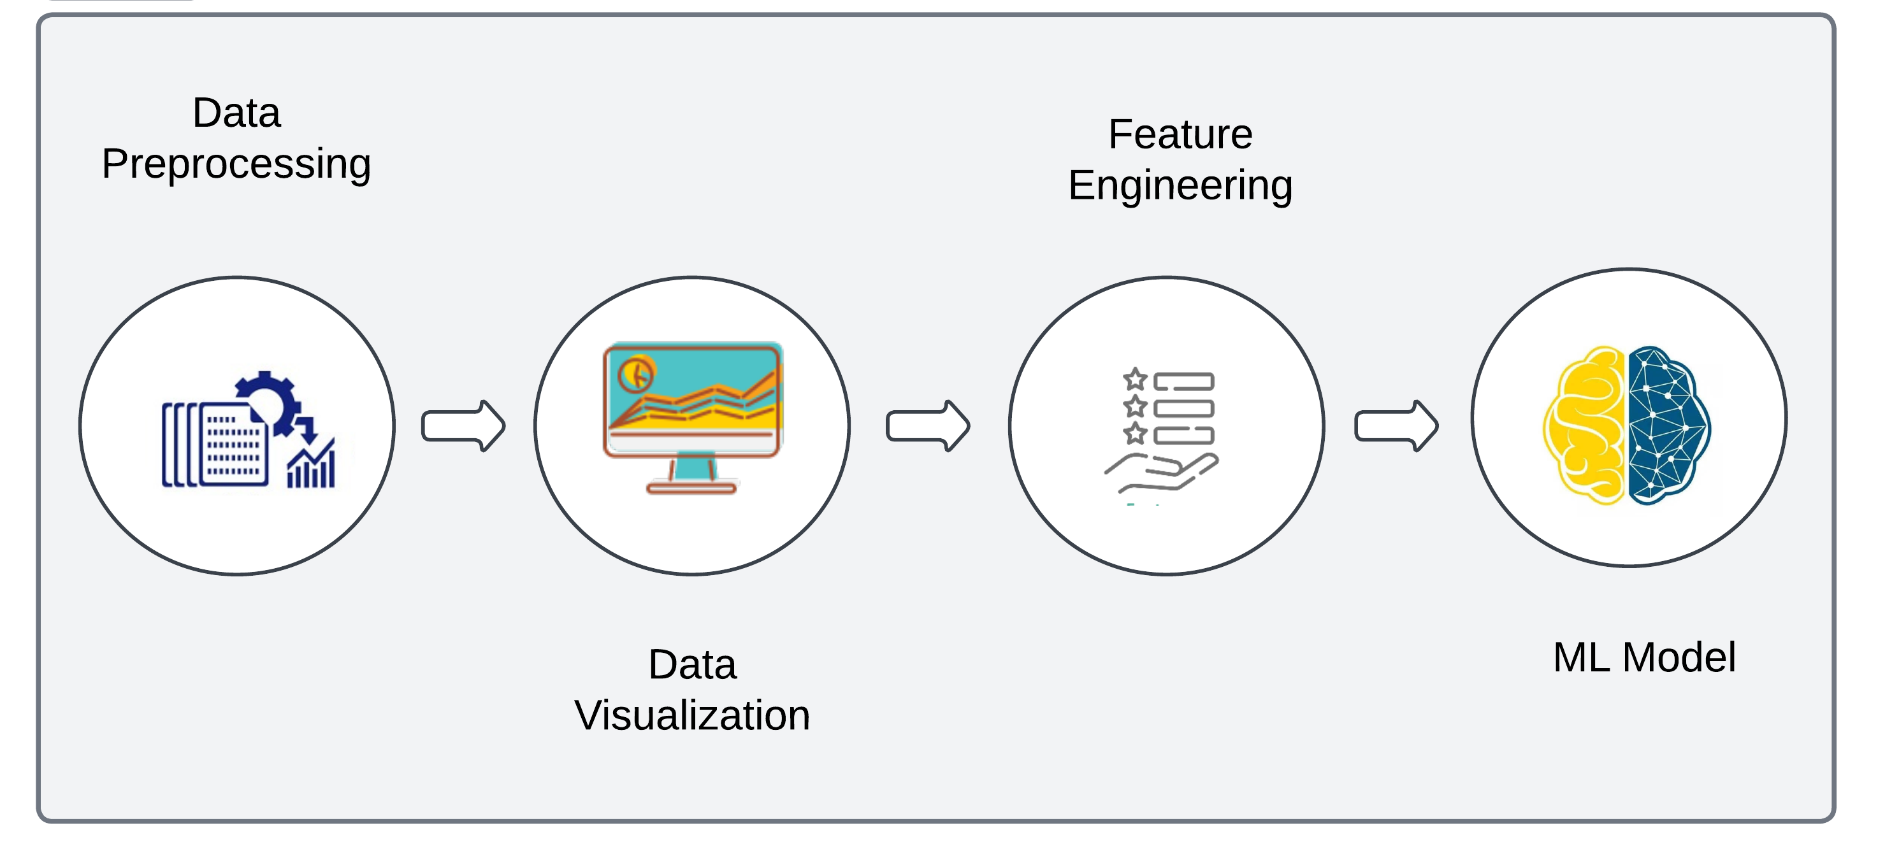
Workflow:

Slide 5
Introduction
Retail Landscape: Dynamic and ever-changing.
Importance: Understanding factors behind return of item.
Dataset: Comprehensive data from Kaggle, spanning two years.
Details: Customer orders, including orderID, orderDate, articleID, colorCode, sizeCode, productGroup, and financial aspects (perUnitPrice, orderPrice, returnPrice).
Objective
Machine Learning Model: Construct a robust machine learning classification model.
Prediction: Determine if an item will be returned or not.

Slide 6
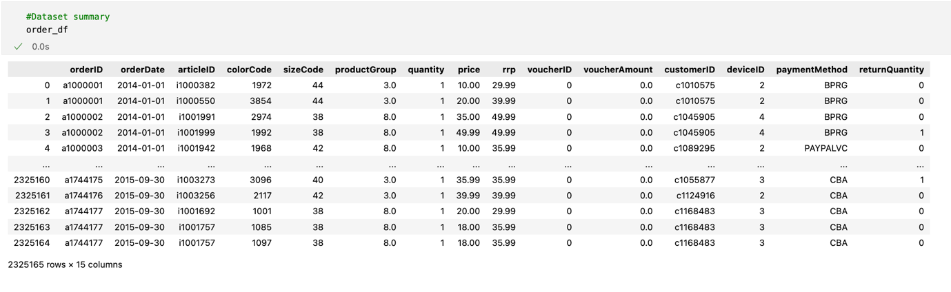
Data Preprocessing:
This involves handling missing values, outliers, and errors in the dataset. Imputing missing values, removing outliers, and correcting errors ensure that the data is reliable for analysis.
Original Data looks like below -

Slide 7
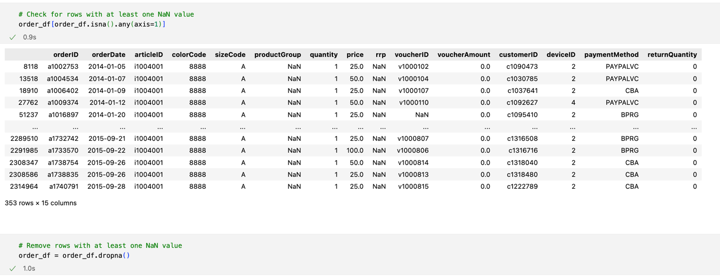
Handling Missing Values:
Checked for NaN values across the dataset and then remove these from it.
Code snippet is as follows -

Slide 8
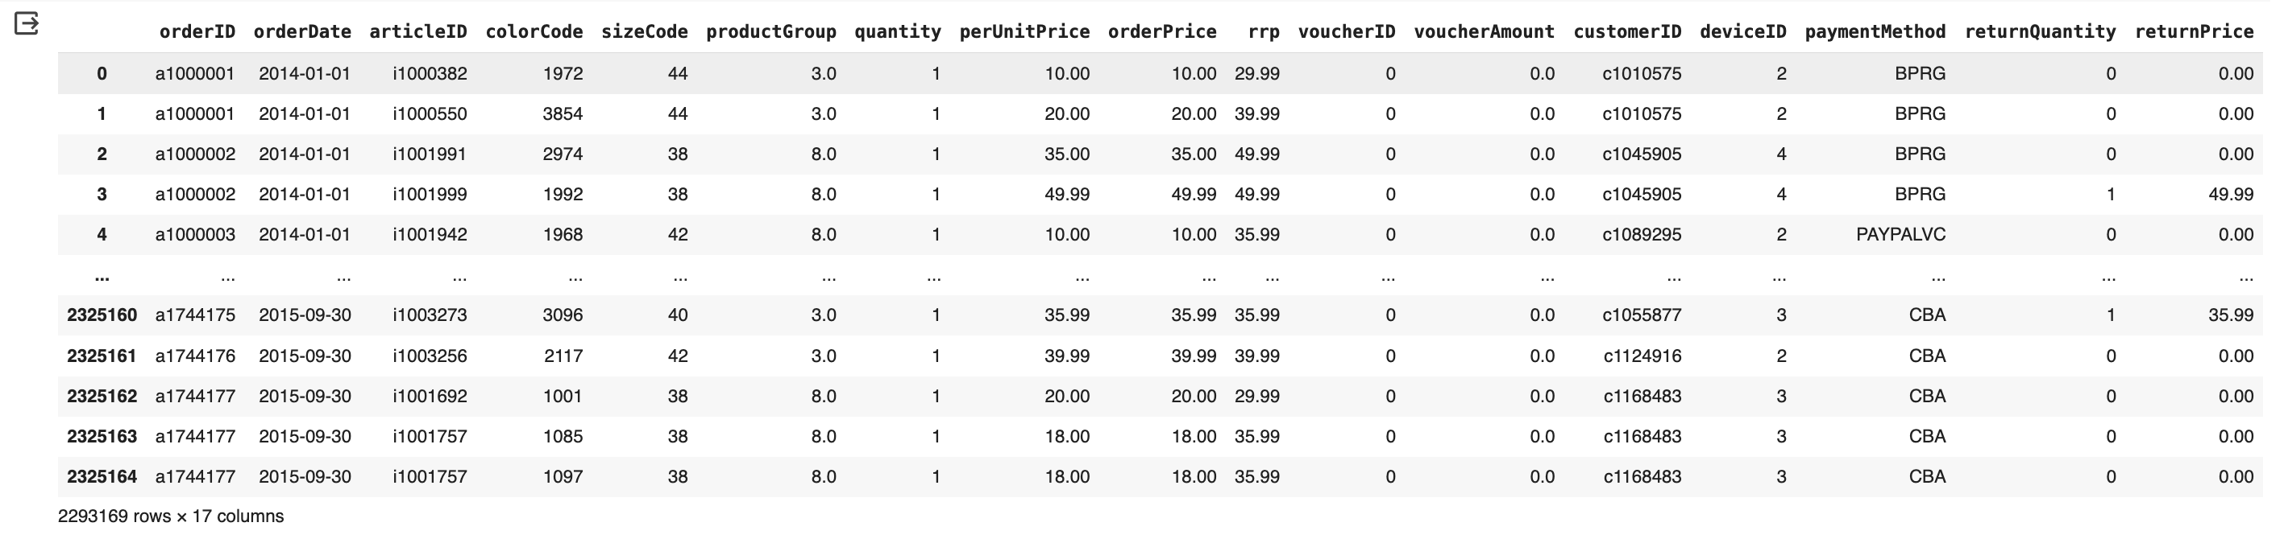
Adding required columns for feature engineering:
Added two new columns (per unit price & return price) into main data frame which is helpful in feature engineering.
Updated DataFrame as follows -

Slide 9
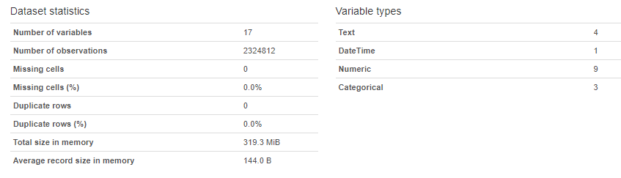
Data Overview:

Slide 10
Valuable insights to explore the data:
Checked for return percentage
Checked unique customer
Checked order placed vs return against each customer
Checked the impact of voucher on return
Checked if price > rrp (retail recommended price)
Checked relation between payment type and return

Slide 11
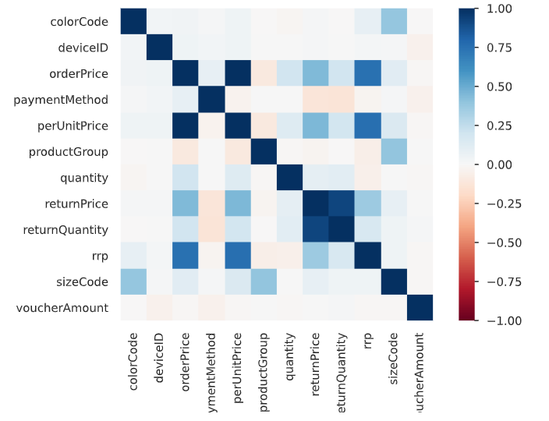
Correlation:

Slide 12
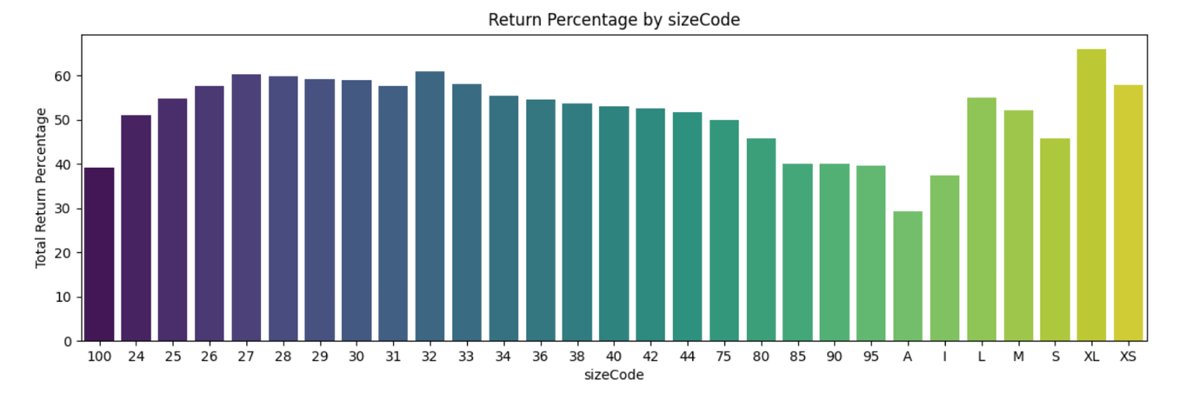
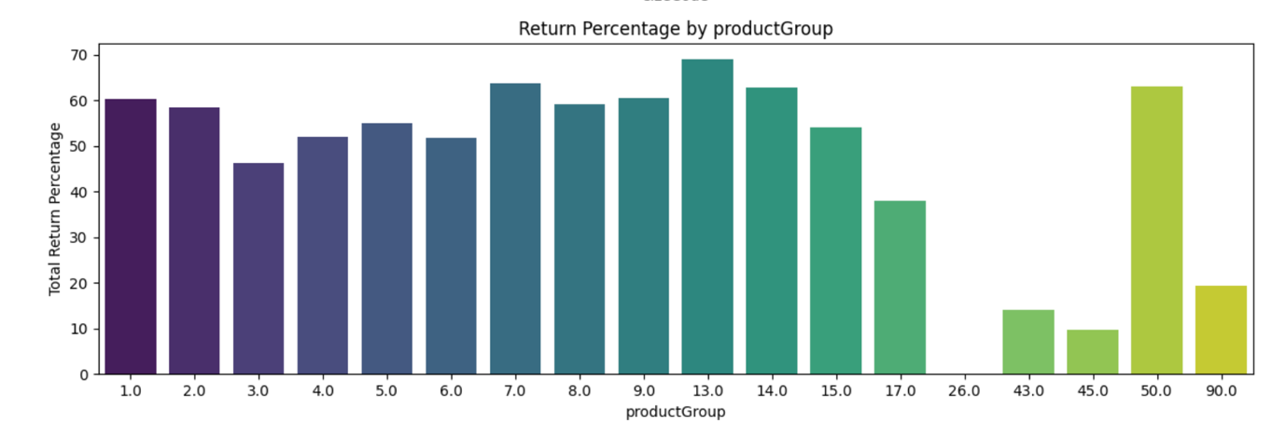
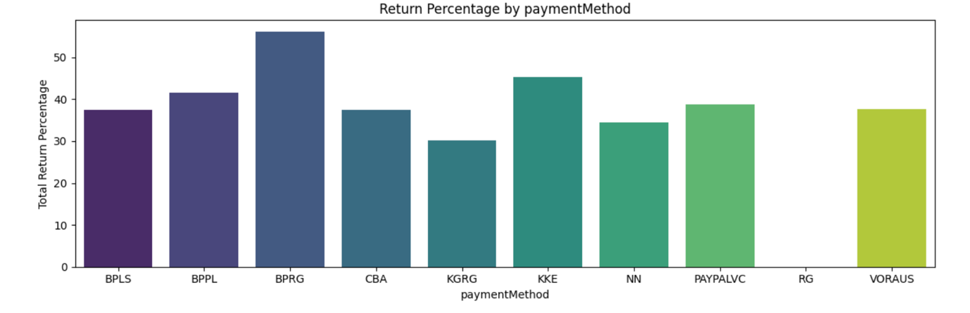
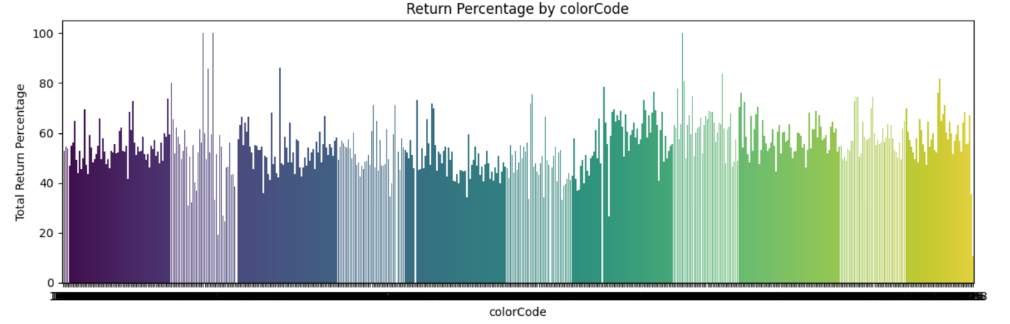
Handling Categorical Columns:

Slide 13
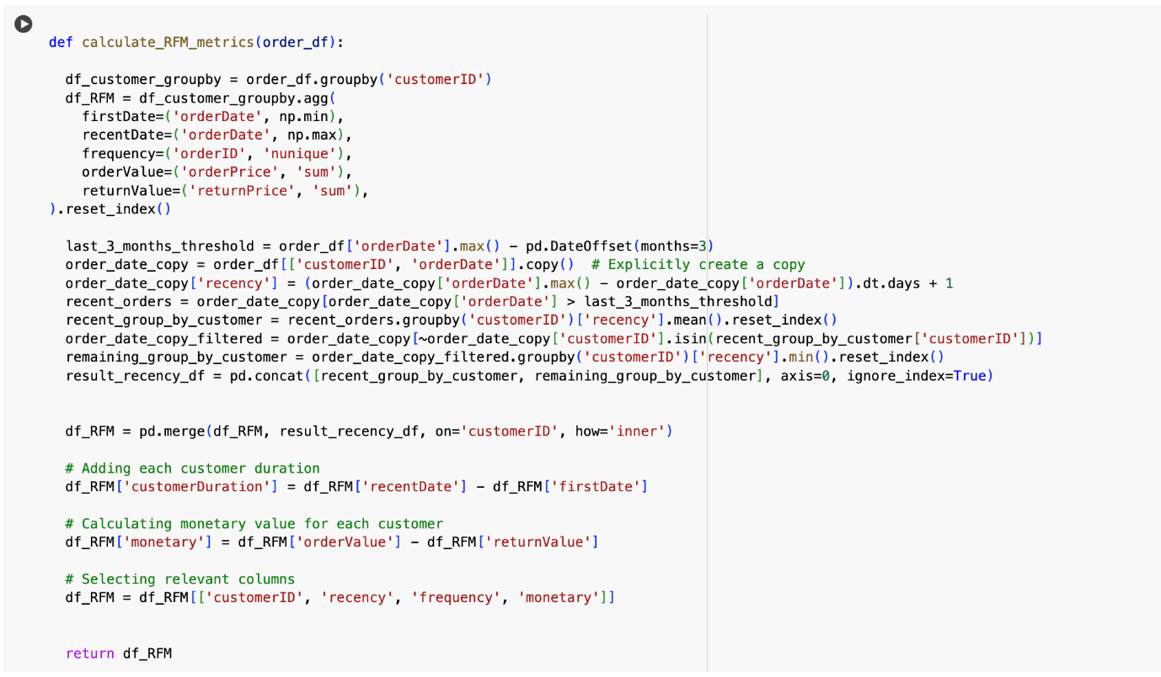
Feature Engineering:
Making new data frames by grouping the data on different parameters like customerID, productGroup, paymentMethod and finally generate RFM for whole data according to unique customer.
After that, finalized to make the feature engineering on three levels:
Customer level feature engineering
Order level feature engineering
Article level feature engineering

Slide 14
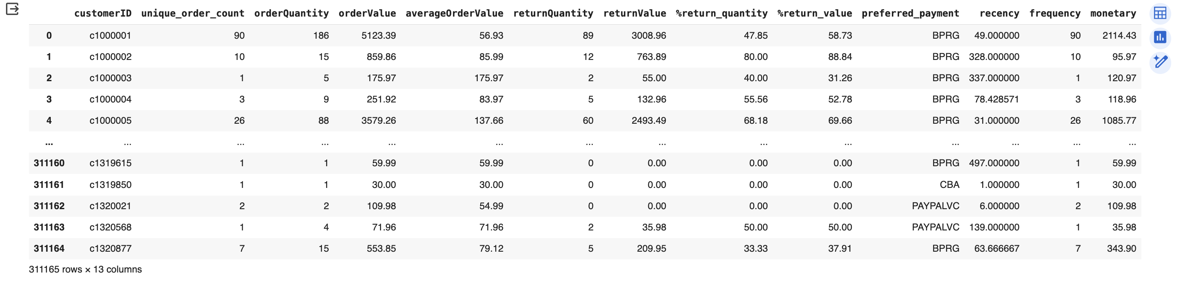
Feature Engineering:
Customer Level Feature Engineering:

Slide 15
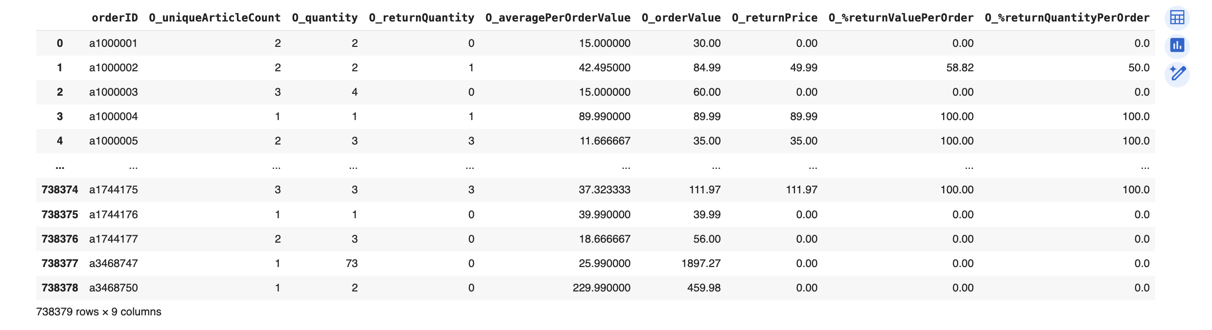
Feature Engineering:
Order Level Feature Engineering:

Slide 16
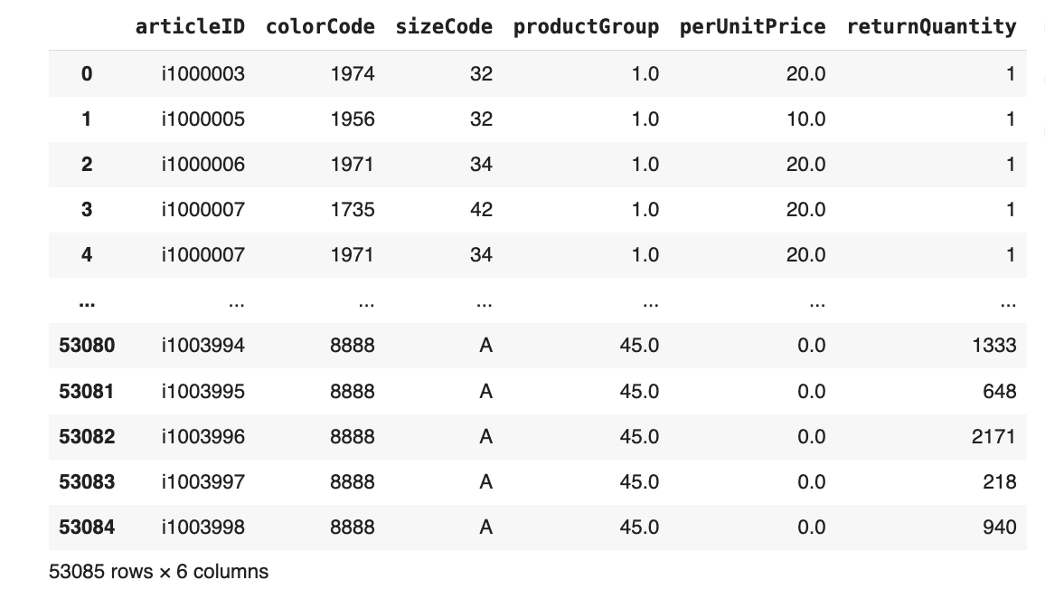
Feature Engineering:
Article Level Feature Engineering:

Slide 17
Model Building
Decision Tree and Random Forest were used on Customer Level, Order Level and combing all features.
Customer Level
Decision Tree
Hyperparameter | Value
Criterion | gini
Max Depth | 5
Min Samples Leaf | 1
Min Samples Split | 2
Splitter | best
Evaluation Metric | Value
Accuracy | 0.754728
Precision | 0.875636
Recall | 0.749028
F1-Score | 0.807399

Slide 18
Model Building
Decision Tree and Random Forest were used on Customer Level, Order Level and combing all features.
Customer Level
Random Forest
Hyperparameter | Value
Criterion | gini
Max Depth | 7
Max Features | auto
Min Samples Leaf | 2
Min Samples Split | 2
n_estimators | 50
Evaluation Metric | Value
Accuracy | 0.750293
Precision | 0.879356
Recall | 0.737346
F1-Score | 0.802114

Slide 19
Model Building
Decision Tree and Random Forest were used on Customer Level, Order Level and combing all features.
Order Level
Decision Tree
Hyperparameter | Value
Criterion | gini
Max Depth | 5
Min Samples Leaf | 1
Min Samples Split | 2
Splitter | best
Evaluation Metric | Value
Accuracy | 0.696579
Precision | 0.844603
Recall | 0.639837
F1-Score | 0.728097

Slide 20
Model Building
Decision Tree and Random Forest were used on Customer Level, Order Level and combing all features.
Combined Features
Decision Tree
Hyperparameter | Value
Criterion | entropy
Max Depth | 9
Min Samples Leaf | 2
Min Samples Split | 7
Splitter | best
Evaluation Metric | Value
Accuracy | 0.638517
Precision | 0.644631
Recall | 0.679204
F1-Score | 0.661466

Slide 21
Model Building
Decision Tree and Random Forest were used on Customer Level, Order Level and combing all features.
Combined Features
Random Forest
Hyperparameter | Value
Criterion | entropy
Max Depth | 7
Max Features | auto
Min Samples Leaf | 2
Min Samples Split | 2
n_estimators | 100
Evaluation Metric | Value
Accuracy | 0.634117
Precision | 0.651163
Recall | 0.638213
F1-Score | 0.644623

Slide 22
Model Performance
 | Model Type | Accuracy | Precision | Recall | F1-score
Customer Level | Decision Tree | 0.7547 | 0.8756 | 0.7490 | 0.8074
 | Random Forest | 0.7503 | 0.8794 | 0.7373 | 0.8021
Order Level | Decision Tree | 0.6966 | 0.8446 | 0.6398 | 0.7281
Combined Features | Decision Tree | 0.6385 | 0.6446 | 0.6792 | 0.6615
 | Random Forest | 0.6341 | 0.6512 | 0.6382 | 0.6446

Slide 23
Future scope
In future scope, we aim to develop a predictive model to estimate the number of articles that will be returned in a cart.
By leveraging historical data on user behavior, purchase patterns, and return rates, our model will forecast the expected quantity of items to be returned.

Slide 24
Thank You

